Slide 1
Recitation 1
Probability Review
Parts of the slides are from previous years’ recitation and lecture notes

Slide 2
Basic Concepts
A sample space S is the set of all possible outcomes of a conceptual or physical, repeatable experiment. (S can be finite or infinite.)
  E.g., S may be the set of all possible outcomes
  of a dice roll:
An event A is any subset of S.
  Eg., A= Event that the dice roll is < 3.

Slide 3
Probability
A probability P(A) is a function that maps an event A onto the interval [0, 1]. P(A) is also called the probability measure or probability mass of A.
Worlds in which A is false
Worlds in which A is true
P(A) is the area of the oval
Notes:
We talk about the probability of something, but what is the precise mathematical definition of “probability”? What is probability? Is it a number, between zero and one, or something else?
A rigorous definition will involve measure theory, but by now we are satisfied to just say “A probability P(A) is a function that maps an event A onto the interval [0, 1].”
One thing that is easy to confuse here is: probability is defined on event space, instead of sample space. When I throw a dice, I can ask the possibility that I get a 6; I can also ask the possibility of getting either 6 or 5.

Slide 4
Kolmogorov Axioms
All probabilities are between 0 and 1
  0 ≤ P(A) ≤ 1
P(S) = 1
P(Φ)=0
The probability of a disjunction is given by
  P(A U B) = P(A) + P(B) − P(A ∩ B)
¬A ∩ ¬B
B
A ∩ B ?
A ∩ B
A
Notes:
Since we define probability as some type of measure on a sample space, probability function must satisfy the four Kolmogorov Axioms.

Slide 5
Random Variable
A random variable is a function that associates a unique number with every outcome of an experiment.
Discrete r.v.:
    The outcome of a dice-roll: D={1,2,3,4,5,6}
  Binary event and indicator variable:
    Seeing a “6" on a toss ⇒ X=1, o/w X=0.
    This describes the true or false outcome a random event.
  Continuous r.v.:
    The outcome of observing the measured location of an aircraft
S
X(ω)
ω
Notes:
Quite often, people fount it is inconvenient to directly work with samples, because samples could be anything, time, location, color, anything. It’ll be more convenient to work just on numbers, at least for mathematicians and statisticians. Therefore we introduce the concept of “random variables”.
A random variable is a function that maps the outcome of an experiment to a numerical value. Let us forget red/blue/green, instead, let’s talk about 1/2/3;

Slide 6
Probability distributions
For each value that r.v X can take, assign a number in [0,1].
Suppose X takes values v₁,…v_{n}.
Then,
  P(X= v₁)+…+P(X= v_{n})= 1.
Intuitively, the probability of X taking value v_{i} is the frequency of getting outcome represented by v_{i}

Slide 7

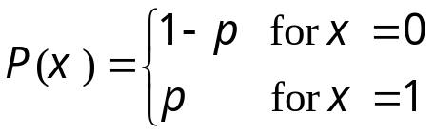



Discrete Distributions
Bernoulli distribution: Ber(p)
Binomial distribution: Bin(n,p)
  Suppose a coin with head prob. p is tossed n times.
  What is the probability of getting k heads?
  How many ways can you get k heads in a sequence of k heads and n-k tails?
Notes:
The simplest discrete distribution is Bernouilli. You throw a coin and you have probability p to get one and probability 1-p to get zero.
Another discrete distribution that will be frequently used in this course is “Multinomial”.

Slide 8



Continuous Prob. Distribution
A continuous random variable X is defined on a continuous sample space: an interval on the real line, a region in a high dimensional space, etc.
  X usually corresponds to a real-valued measurements of some property, e.g., length, position, …
  It is meaningless to talk about the probability of the random variable assuming a particular value --- P(x) = 0
  Instead, we talk about the probability of the random variable assuming a value within a given interval, or half interval, etc.

Slide 9
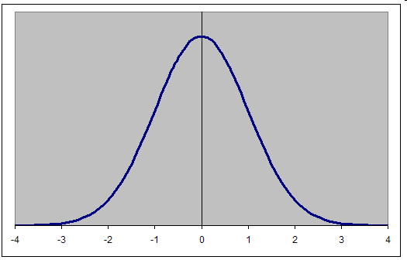
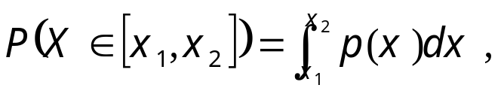
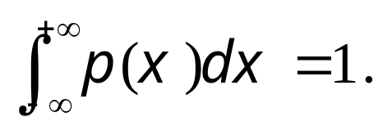
Probability Density
If the prob. of x falling into [x, x+dx] is given by p(x)dx for dx , then p(x) is called the probability density over x.
The probability of the random variable assuming a value within some given interval from x₁ to x₂ is equivalent to the area under the graph of the probability density function between x₁ and x₂.
Probability mass:
Gaussian
Distribution

Slide 10
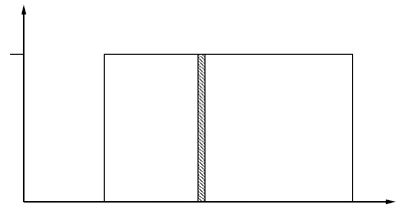
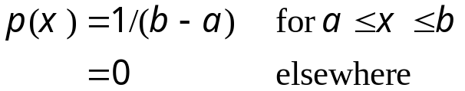
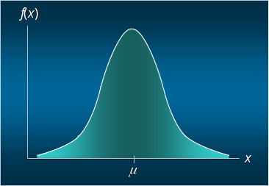
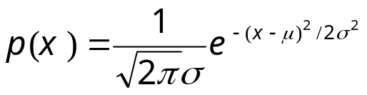
Continuous Distributions
Uniform Density Function
Normal (Gaussian) Density Function
  The distribution is symmetric, and is often illustrated
  as a bell-shaped curve.
  Two parameters, μ (mean) and σ (standard deviation), determine the location and shape of the distribution.
  The highest point on the normal curve is at the mean, which is also the median and mode.
Notes:
The time until the next bus comes, or phones rings. Tightly related to Poisson distribution and Poisson process.
Mu is called rated parameter.

Slide 11
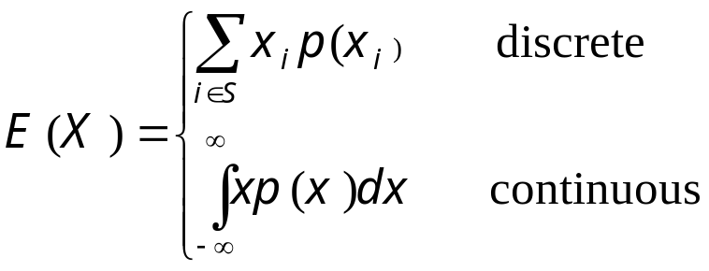
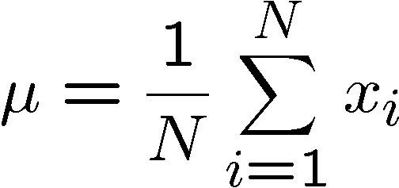
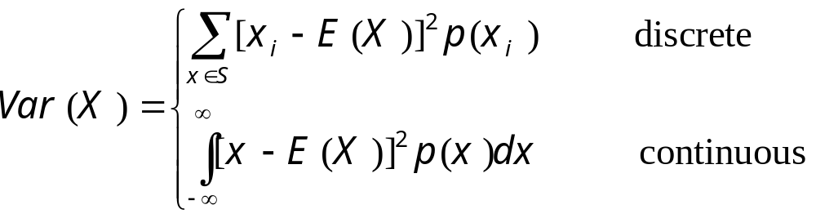
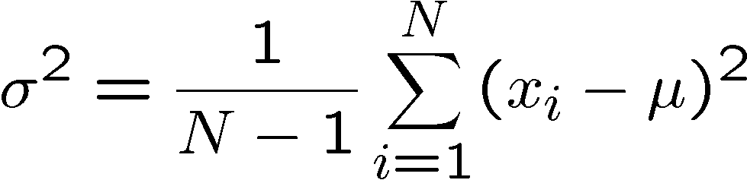
Statistical Characterizations
Expectation: the centre of mass, mean, first moment):
  Sample mean:
Variance: the spread:
  Sample variance:

Slide 12
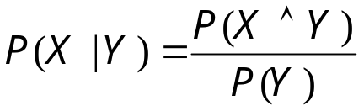

Conditional Probability
P(X|Y) = Fraction of worlds in which X is true given Y is true
  H = "having a headache"
  F = "coming down with Flu"
    P(H)=1/10
    P(F)=1/40
    P(H|F)=1/2
  P(H|F) = fraction of headache given you have a flu
  = P(H∧F)/P(F)
Definition:
  Corollary: The Chain Rule
Y
X∧Y
X

Slide 13
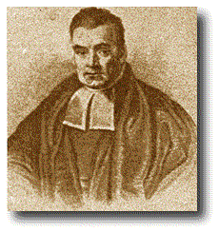
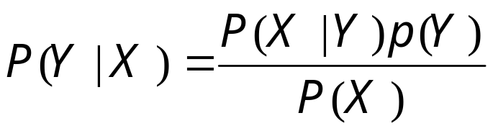
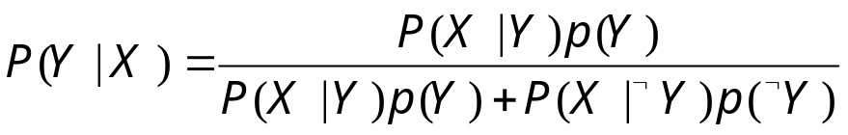
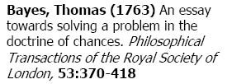
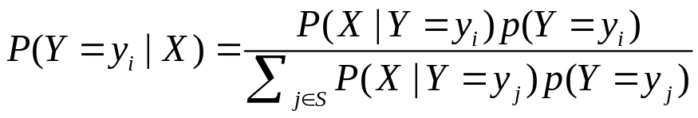
The Bayes Rule
What we have just did leads to the following general expression:
This is Bayes Rule

Slide 14
Probabilistic Inference
  H = "having a headache"
  F = "coming down with Flu"
    P(H)=1/10
    P(F)=1/40
    P(H|F)=1/2
The Problem:
P(F|H) = ?
F
F∧H
H

Slide 15
Joint Probability
A joint probability distribution for a set of RVs gives the probability of every atomic event (sample point)
  P(Flu,DrinkBeer) = a 2 × 2 matrix of values:
  Every question about a domain can be answered by the joint distribution, as we will see later.
 | B | ¬B
F | 0.005 | 0.02
¬F | 0.195 | 0.78

Slide 16

Inference with the Joint
Compute Marginals
¬F | ¬B | ¬H | 0.4
¬F | ¬B | H | 0.1
¬F | B | ¬H | 0.17
¬F | B | H | 0.2
F | ¬B | ¬H | 0.05
F | ¬B | H | 0.05
F | B | ¬H | 0.015
F | B | H | 0.015
B
F
H

Slide 17

Inference with the Joint
Compute Marginals
¬F | ¬B | ¬H | 0.4
¬F | ¬B | H | 0.1
¬F | B | ¬H | 0.17
¬F | B | H | 0.2
F | ¬B | ¬H | 0.05
F | ¬B | H | 0.05
F | B | ¬H | 0.015
F | B | H | 0.015
B
F
H

Slide 18
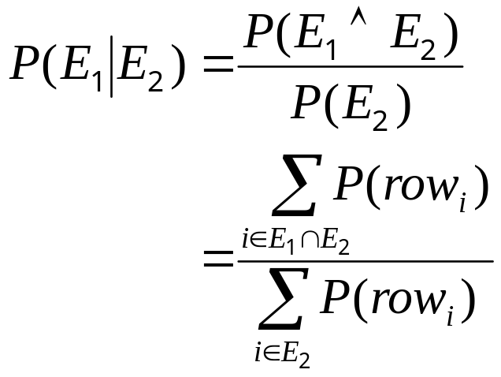
Inference with the Joint
Compute Conditionals
¬F | ¬B | ¬H | 0.4
¬F | ¬B | H | 0.1
¬F | B | ¬H | 0.17
¬F | B | H | 0.2
F | ¬B | ¬H | 0.05
F | ¬B | H | 0.05
F | B | ¬H | 0.015
F | B | H | 0.015
B
F
H

Slide 19
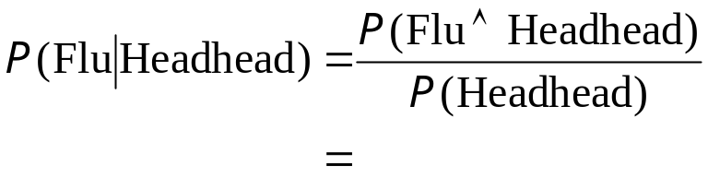
Inference with the Joint
Compute Conditionals
  General idea: compute distribution on query
  variable by fixing evidence variables and
  summing over hidden variables
¬F | ¬B | ¬H | 0.4
¬F | ¬B | H | 0.1
¬F | B | ¬H | 0.17
¬F | B | H | 0.2
F | ¬B | ¬H | 0.05
F | ¬B | H | 0.05
F | B | ¬H | 0.015
F | B | H | 0.015
B
F
H

Slide 20
Conditional Independence
Random variables X and Y are said to be independent if:
  P(X ∩ Y) =P(X)*P(Y)
Alternatively, this can be written as
  P(X | Y) = P(X) and
  P(Y | X) = P(Y)
Intuitively, this means that telling you that Y happened, does not make X more or less likely.
Note: This does not mean X and Y are disjoint!!!
Y
X∧Y
X

Slide 21
Rules of Independence
--- by examples
P(Virus | DrinkBeer) = P(Virus)
iff Virus is independent of DrinkBeer
P(Flu | Virus;DrinkBeer) = P(Flu|Virus)
iff Flu is independent of DrinkBeer, given Virus
P(Headache | Flu;Virus;DrinkBeer) = P(Headache|Flu;DrinkBeer)
iff Headache is independent of Virus, given Flu and DrinkBeer

Slide 22
Marginal and Conditional Independence
Recall that for events E (i.e. X=x) and H (say, Y=y), the conditional probability of E given H, written as P(E|H), is
P(E and H)/P(H)
(= the probability of both E and H are true, given H is true)
E and H are (statistically) independent if
P(E) = P(E|H)
(i.e., prob. E is true doesn't depend on whether H is true); or equivalently
P(E and H)=P(E)P(H).
E and F are conditionally independent given H if
P(E|H,F) = P(E|H)
or equivalently
P(E,F|H) = P(E|H)P(F|H)

Slide 23
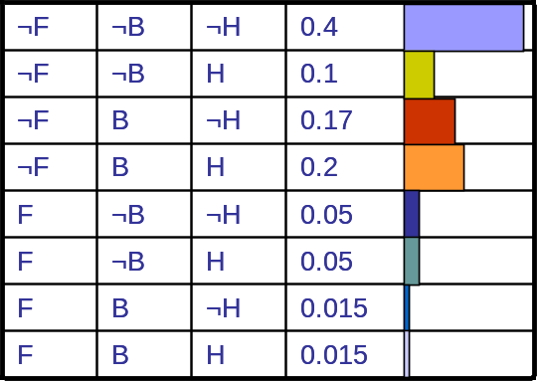
Why knowledge of Independence is useful
x
Lower complexity (time, space, search …)
Motivates efficient inference for all kinds of queries
Structured knowledge about the domain
  easy to learning (both from expert and from data)
  easy to grow

Slide 24

Density Estimation
A Density Estimator learns a mapping from a set of attributes to a Probability
Often know as parameter estimation if the distribution form is specified
  Binomial, Gaussian …
Three important issues:
  Nature of the data (iid, correlated, …)
  Objective function (MLE, MAP, …)
  Algorithm (simple algebra, gradient methods, EM, …)
  Evaluation scheme (likelihood on test data, predictability, consistency, …)

Slide 25

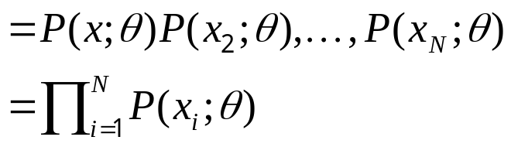
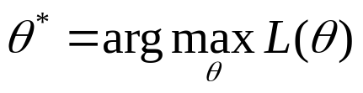
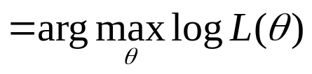
Parameter Learning from iid data
Goal: estimate distribution parameters θ from a dataset of N independent, identically distributed (iid), fully observed, training cases
D = {x₁, . . . , x_{N}}
Maximum likelihood estimation (MLE)
  One of the most common estimators
  With iid and full-observability assumption, write L(θ) as the likelihood of the data:
  pick the setting of parameters most likely to have generated the data we saw:

Slide 26

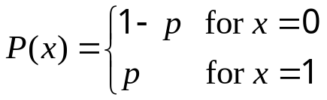


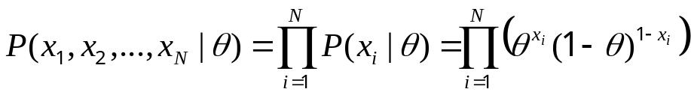
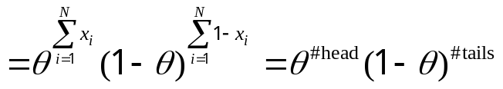
Example 1: Bernoulli model
Data:
  We observed N iid coin tossing: D={1, 0, 1, …, 0}
Representation:
  Binary r.v:
Model:
How to write the likelihood of a single observation x_{i} ?
The likelihood of datasetD={x₁, …,x_{N}}:

Slide 27
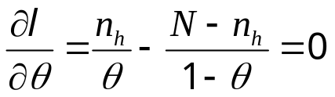
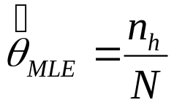
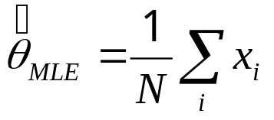
MLE
Objective function:
We need to maximize this w.r.t. θ
Take derivatives wrt θ
or
Frequency as sample mean

Slide 28
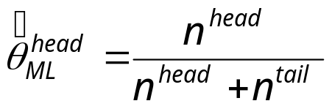

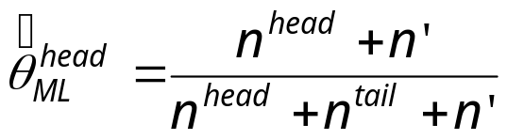
Overfitting
Recall that for Bernoulli Distribution, we have
What if we tossed too few times so that we saw zero head?
We have and we will predict that the probability of seeing a head next is zero!!!
The rescue:
  Where n' is know as the pseudo- (imaginary) count
  But can we make this more formal?

Slide 29

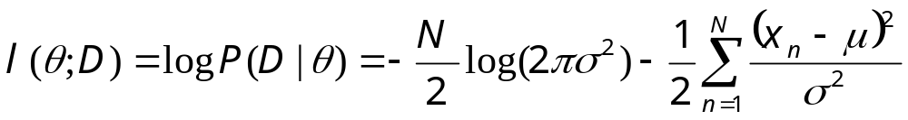
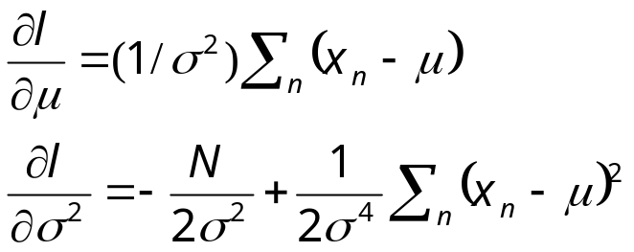
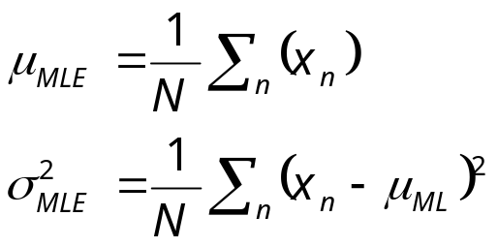
Example 2: univariate normal
Data:
  We observed N iid real samples:
  D={-0.1, 10, 1, -5.2, …, 3}
Model:
Log likelihood:
MLE: take derivative and set to zero:

Slide 30
The Bayesian Theory
The Bayesian Theory: (e.g., for date D and model M)
P(M|D) = P(D|M)P(M)/P(D)
  the posterior equals to the likelihood times the prior, up to a constant.
This allows us to capture uncertainty about the model in a principled way

Slide 31
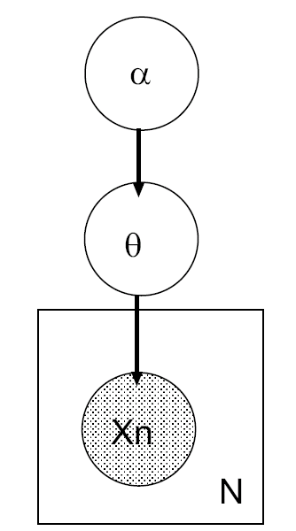
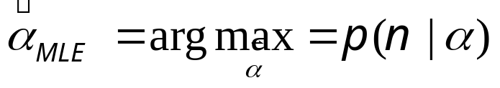
Hierarchical Bayesian Models
θ are the parameters for the likelihood p(x|θ)
α are the parameters for the prior p(θ|α) .
We can have hyper-hyper-parameters, etc.
We stop when the choice of hyper-parameters makes no difference to the marginal likelihood; typically make hyper-parameters constants.
Where do we get the prior?
  Intelligent guesses
  Empirical Bayes (Type-II maximum likelihood)
  → computing point estimates of α :

Slide 32
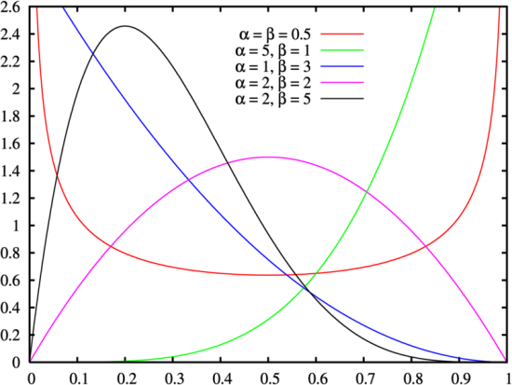
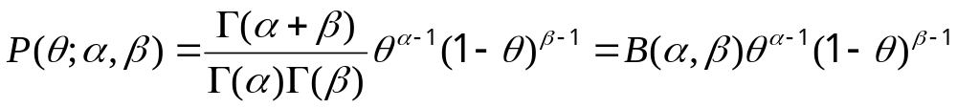
Bayesian estimation for Bernoulli
Beta distribution:
Posterior distribution of θ :
  Notice the isomorphism of the posterior to the prior,
  such a prior is called a conjugate prior

Slide 33
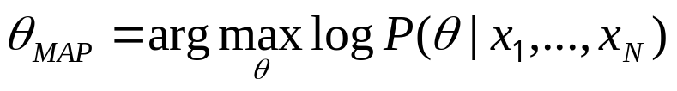
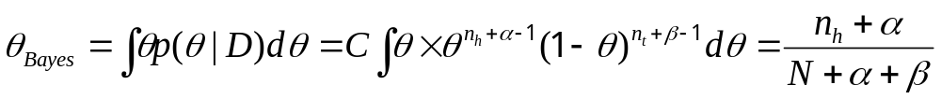
Bayesian estimation for Bernoulli, con'd
Posterior distribution of θ :
Maximum a posteriori (MAP) estimation:
Posterior mean estimation:
Prior strength: A=α+β
  A can be interoperated as the size of an imaginary data set from which we obtain the pseudo-counts
Bata parameters can be understood as pseudo-counts

Slide 34
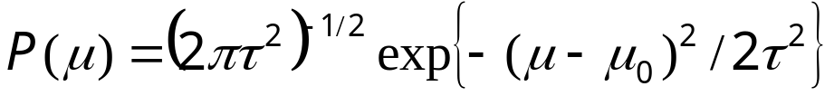
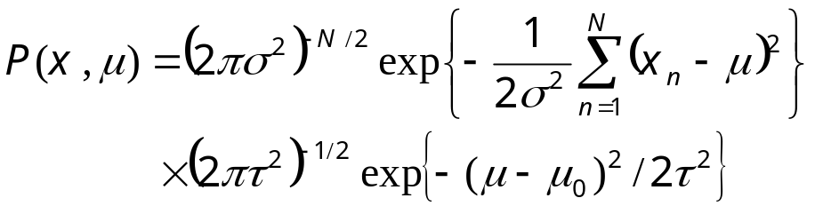
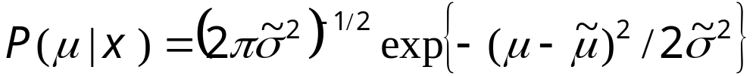
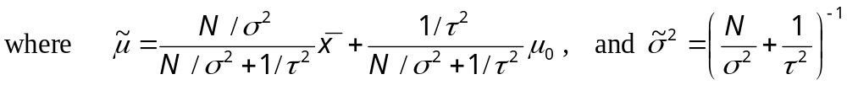
Bayesian estimation for normal distribution
Normal Prior:
Joint probability:
Posterior:
Sample mean

